Slide 1
Northstar Procurement Strategy
Aaron, Aryan, Jose, Toby

Slide 2
Diagnosis
Strengths to Maximize Opportunities: Because there is a high purchasing power/leverage, there is an opportunity to further drive down total costs through negotiating with various carriers in their network.
Strength to Minimize Threats: Because they have high purchasing power, they can negotiate costs in areas that they feel they are overspending or for opportunities to save. Strong global presence can help integrate purchasing practices across plants by allowing global knowledge sharing across all international plants, clients, and carriers.
Weakness: The coverage % of total contracts is low so we want to reduce the risk of commercial and continuity risk by increasing this %.
Two Issues we are focusing on: Purchasing process across all plants and high carrier count

Slide 3
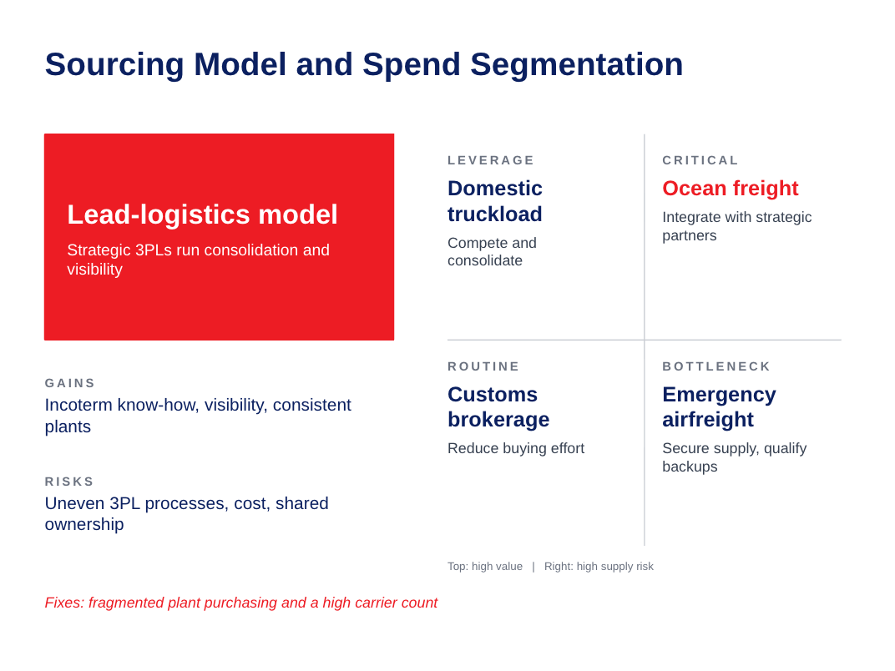
Notes:
Domestic - high in value
Critical - hard to replace
Routine - many providers
Bottleneck - anternatives limited

Slide 4
Economics: Total Cost of Ownership (TCO)
Decision rule: award on lowest total landed cost, not lowest rate.
$120M
addressable annual logistics spend
96
active carriers: fragmented, little leverage
$7.2M
expedite/accessorial cost = 6% of spend
91%
OTIF; contract coverage only 58%
Pre-transaction | Transaction | Post-transaction
Data cleaning | Base rate | Late-delivery impact
RFI / qualification | Fuel | Damage / claims
Contracting | Accessorials | Expediting
Systems onboarding | Duties / brokerage | Management time
Why the lowest rate can cost more
A 3% rate cut on $120M saves $3.6M.
Baseline: $7.2M of expedite/accessorial cost at 91% OTIF (9 missed points) is about $0.8M per OTIF point.
A cheaper carrier that costs 5 OTIF points adds about $4.0M, a net loss of ~$0.4M.

Slide 5
Economics: Scorecard and Savings Case
Dimension | Weight | Measured by
Total landed logistics cost | 35% | Rate + fuel + accessorials + duties
Service and capacity | 25% | OTIF, claims/damage, surge capacity
Supply risk and continuity | 15% | Backup capacity, financial health
Technology / visibility | 10% | EDI, tracking, TMS integration
Sustainability / responsibility | 10% | Emissions reporting, ESG compliance
Implementation fit | 5% | Onboarding effort, regional coverage
Total | 100%
Annual savings
Rate leverage from consolidation
3-5% of $120M = $3.6-6.0M
Fewer expedites/accessorials
25-35% of $7.2M = $1.8-2.5M
Gross savings
about $5.4-8.5M per year (4.5-7.1% of spend)
Offsets
One-time TMS and carrier-transition costs, to be sized; we require payback within 18 months.
Pass/fail gates:
Incoterm-compliant bids in standard units and currency | valid insurance and regulatory compliance | EDI/tracking connectivity | OTIF at or above the 91% baseline
Why these weights: cost 35% to capture leverage on $120M; service 25% because 91% OTIF is the gap; risk 15% because contract coverage is only 58%. Savings are estimates, not case data.

Slide 6
Execution
Initiatives:
Improve spend visibility
-Create a standardized system to track and compare logistics spending across all regions, modes, currencies, and lanes
Carrier Rationalization and consolidation
-Reduce the 96-carrier base and consolidate volume with fewer high-performing carriers to increase buying leverage.
Carrier performance management
-Use standardized scorecards and quarterly reviews to consistently measure and improve carrier performance
Owners:
Finance lead
-Owns spend visibility by collecting, cleaning, and standardizing transportation data across the company.
Procurement lead
-Owns carrier rationalization by evaluating carriers and determining where volume can be strategically consolidated
KPI’s:
% of logistics spend visible
-Measures how much of NorthStar's $120M logistics spend can be accurately analyzed and compared
# of active carriers / % spend with preferred carriers
-Measures progress in reducing fragmentation and concentrating volume with strategic carriers
OTIF% / % spend covered by scorecards
-Measures carrier service improvement and how consistently NorthStar evaluates carrier performance. Current OTIF is 91%, while only 35% of spend has performance scorecards

Slide 7
Risk and Mitigation
MAJOR FAILURE: Disparity between the 3PLs and their different processes
Difference in regional understanding between 3PLs
3PLs may process purchases and transportation process differently, so differences in
  Lead time
  Reporting issues
  Standards
Can lead to non-compliance, incoterm issues, and prove to be less cost-efficient
MITIGATION:
To remove disparity with Incoterms
  Incorporate a global routing mandate to ensure over-sea and cross-border compliance is in check for all 3PL partners
Create a Transportation Management System (TMS) to have a centralized location for reports and KPIs
Having an internal logistics team that can monitor all 3PLs, to ensure all procedure is followed
Hold benchmark meetings with 3PLs to gain updates and understandings

